Slide 1

Big Data
Simply Explained

Slide 2

What is Big Data?
Big Data refers to datasets that are too large and complex for traditional data processing tools to handle efficiently.

Slide 3

Big Data is characterized by the 3 Vs
Volume: Big Data involves large amounts of data, often ranging from terabytes to petabytes and beyond. Traditional databases may struggle to handle such immense volumes.
Velocity: Data is generated at high speed, often in real-time or near-real-time. This is common in applications like social media, sensor data, and financial transactions.
Variety: Big Data comes in various formats, including structured (e.g., databases), semi-structured (e.g., JSON, XML), and unstructured (e.g., text, images, videos). Traditional databases are typically optimized for structured data.

Slide 4

2 Other Vs of a Big Data
Veracity: Refers to the quality of the data. Big Data can include noisy, incomplete, or inconsistent data, requiring sophisticated processing techniques.
Value: The ultimate goal of Big Data is to extract valuable insights and knowledge from the massive amounts of data, leading to informed decision-making

Slide 5
How is Big Data Different from Traditional data
Scale: Big Data involves much larger volumes than traditional data.
Speed: Big Data often requires real-time or near-real-time processing, while traditional data processing may be more batch-oriented.
Structure: Traditional data is usually structured and fits neatly into relational databases, while Big Data includes unstructured and semi-structured data.
Tools: Traditional data processing tools, like relational databases, may not scale well to handle Big Data. New tools and technologies are needed for storage, processing, and analysis.

Slide 6

Challenges with Super Computers

Slide 7

Challenges with super computers
A general purpose operating system like framework for parallel computing needs did not exist
Companies procuring super computers were locked to specific vendors for hardware support
High initial cost of the hardware
Develop custom software for individual use cases
High cost of software maintenance and upgrades which had to be taken care in house the organizations using a super computer.
Not simple to scale horizontally

Slide 8
HADOOP Comes to the Rescue

Slide 9

How Hadoop comes to the rescue in case of large datasets
A general-purpose operating system like framework for parallel computing needs
Its free software (open source) with free upgrades
Has options for upgrading the software and its free !
Opens up the power of distributed computing to a wider set of audience.
Mid sized organizations need not be locked to specific vendors for hardware support – Hadoop works on commodity hardware
The software challenges of the organization having to write proprietary software is no longer the case.

Slide 10

But what is this Hadoop Basically?

Slide 11

What is Hadoop?
Hadoop is an open-source framework for distributed storage and processing of large datasets. It is designed to scale from single servers to thousands of machines, offering a reliable and cost-effective solution for handling Big Data.
The core components of Hadoop include the Hadoop Distributed File System (HDFS), which is a distributed file storage system, and MapReduce, a programming model for processing and generating large datasets.

Slide 12

Hadoop Distributed File System (HDFS)
HDFS is a distributed file system that allows data to be distributed across multiple nodes in a Hadoop cluster.
It provides high-throughput access to data and fault tolerance, allowing the system to continue operating even if some nodes fail.

Slide 13
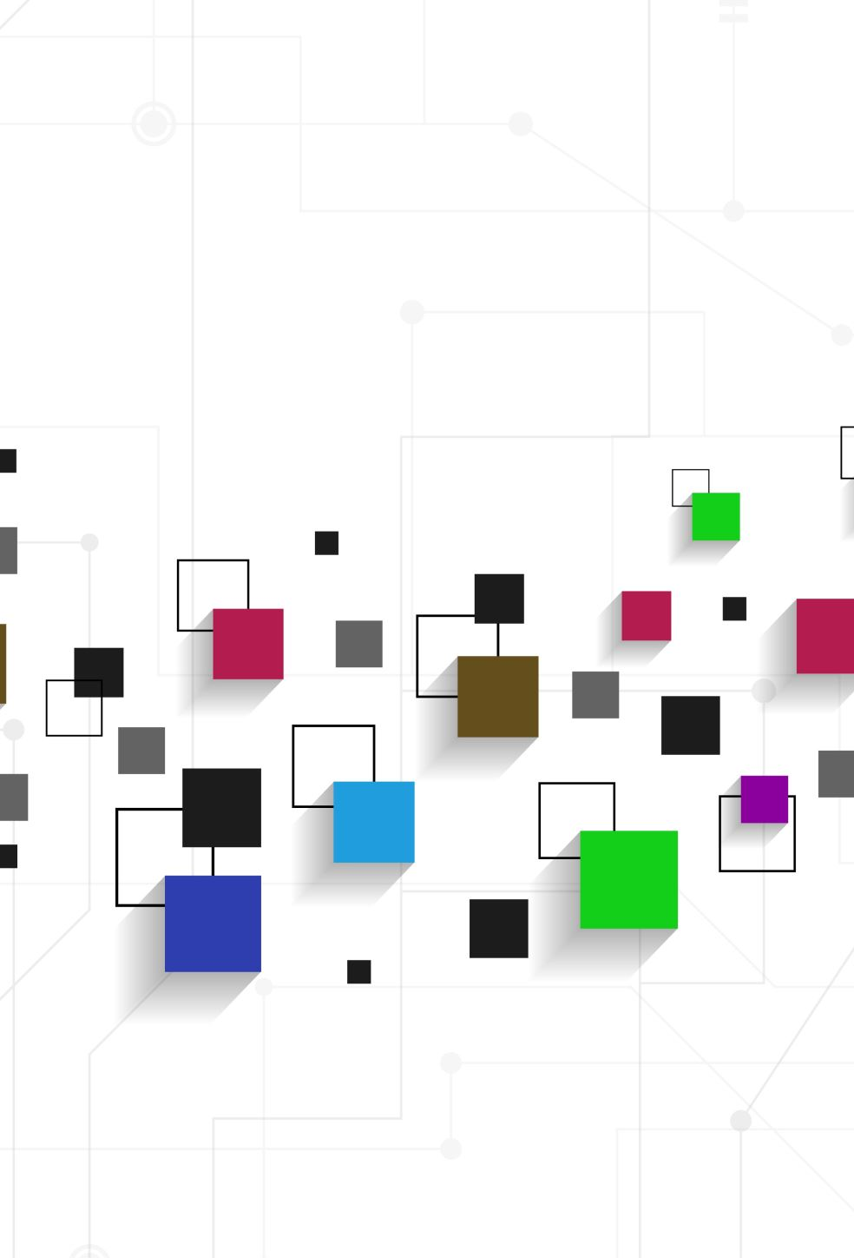
MapReduce
MapReduce is a programming model and processing engine used in Hadoop for distributed data processing. It breaks down a large computation into smaller tasks that can be executed in parallel across a cluster of computers.
The MapReduce process consists of two main phases: the Map phase, where data is divided into key-value pairs and processed in parallel, and the Reduce phase, where the results from the Map phase are combined and processed to produce the final output.

Slide 14

Hive
Hive is a data warehousing and SQL-like query language for Hadoop. It provides a higher-level abstraction over MapReduce, making it easier for users to work with large datasets using a familiar SQL-like syntax.
With Hive, users can write queries in HiveQL, a SQL-like language, which are then translated into MapReduce jobs by the Hive engine. This allows analysts and data scientists to leverage the power of Hadoop without needing to write complex MapReduce programs.

Slide 15
Summary
Big Data is the concept of dealing with large and complex datasets, while Hadoop is an open-source framework for distributed storage and processing. MapReduce is the programming model used within Hadoop for parallel data processing, and Hive is a higher-level abstraction that allows users to query and analyze data stored in Hadoop using SQL-like commands. These technologies play a crucial role in addressing the challenges associated with handling massive amounts of data efficiently.

